Slide 1
Design and Analysis of Algorithms
CS345
Lecture 4
Divide and Conquer Paradigm - III
  A number theoretic algorithm

Slide 2
Divide and Conquer paradigm

Slide 3
An Overview
of today’s problem
Divide the problem instance into two or more instances of the same problem.
Solve each smaller instance recursively (base case suitably defined).
Combine the solutions of the smaller instances
to get the solution of the original instance.
Notes:
How do we solve any problem in this paradigm ?
The 3rd step (Combine step) is usually the main nontrivial step in the design of an algorithm using divide and conquer strategy

Slide 4
An Overview
of today’s problem
Most non-trivial and novel algorithm
Invented by Gauss
Applications: Signal Processing (Discrete Fourier Transform)
Amazing role of Complex numbers
Joy for programmers

Slide 5
An algorithm for multiplying two polynomials
Problem 3

Slide 6
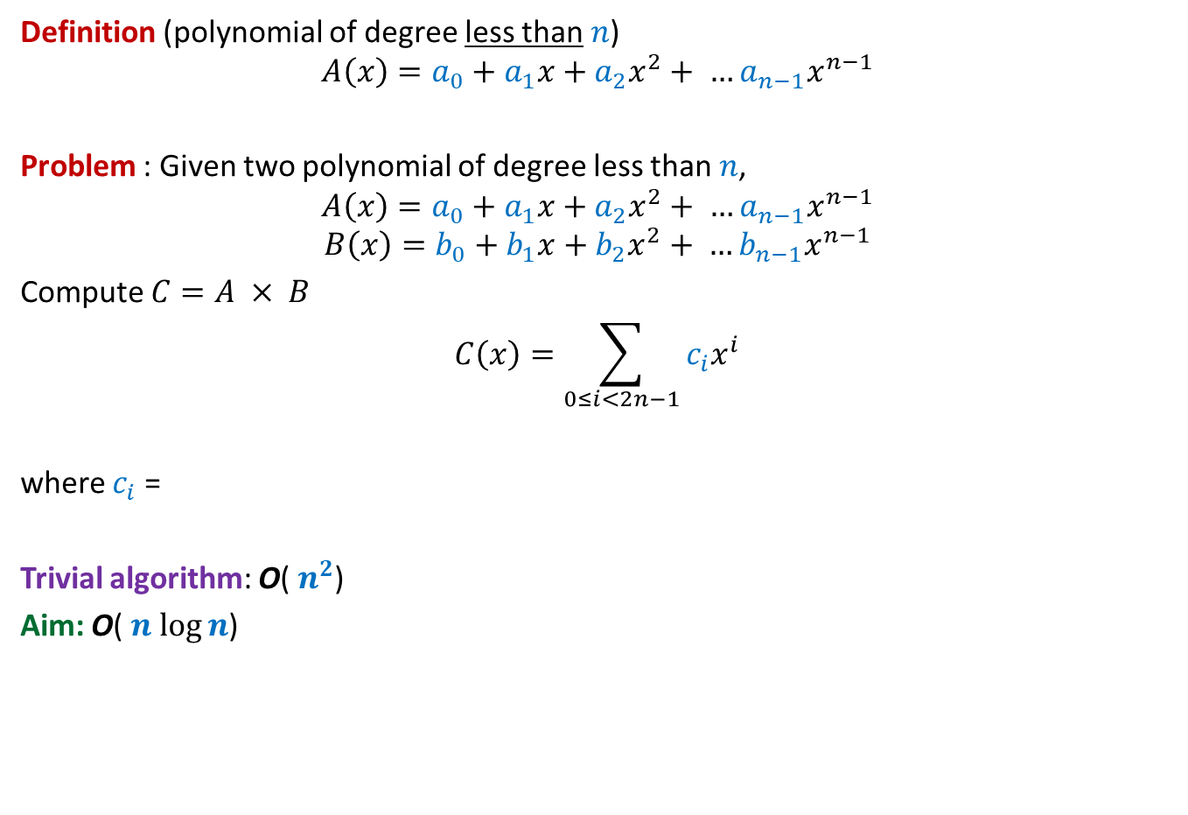

Multiplying two polynomials
Definition (polynomial of degree less than $n$)
$$A\left(x\right)=a_{0}+a_{1}x+a_{2}x^{2}+ …a_{n−1}x^{n−1}$$
Problem : Given two polynomial of degree less than $n$,
$$A\left(x\right)=a_{0}+a_{1}x+a_{2}x^{2}+ …a_{n−1}x^{n−1}$$
$$B\left(x\right)=b_{0}+b_{1}x+b_{2}x^{2}+ …b_{n−1}x^{n−1}$$
Compute $C=A × B$
$$C\left(x\right)=\sum_{0≤i<2n−1}{c_{i}x^{i}}$$
where $c_{i}$ =
Trivial algorithm: O( $n^{2}$)
Aim: O( $n$ $\log{n}$)
$$a_{0}b_{i}+a_{1}b_{i−1}+a_{2}b_{i−2}+ …+a_{i−1}b_{1}+a_{i}b_{0}$$
O($i$) time
Assumption:
$n$ is a power of 2.

Slide 7

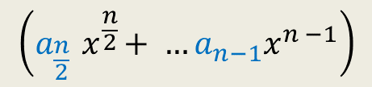


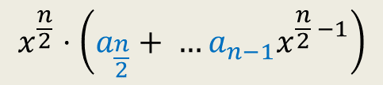

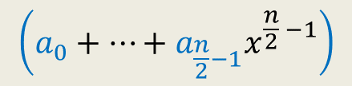

Divide Step
Attempt 1
$$A\left(x\right)=a_{0}+a_{1}x+a_{2}x^{2}+ …a_{n−1}x^{n−1}$$
$$A\left(x\right)= ? + ?$$
$$A\left(x\right)=A_{first}\left(x\right)+{ x}^{\frac{n}{2}} A_{second}\left(x\right)$$
$$\left(a_{0}+…+a_{\frac{n}{2}−1}x^{\frac{n}{2} −1}\right)$$
$$x^{\frac{n}{2}}⋅\left(a_{\frac{n}{2}}+ …a_{n−1}x^{\frac{n}{2} −1}\right)$$
$$\left(a_{\frac{n}{2}}{ x}^{\frac{n}{2}}+ …a_{n−1}x^{n −1}\right)$$
First $\frac{n}{2}$ terms of $A\left(x\right)$
Last $\frac{n}{2}$ terms of $A\left(x\right)$
$$A_{first}\left(x\right)$$
$$A_{second}\left(x\right)$$
Notes:
We can evaluate x^{n/2} in log n time for any given value of x: by repeated squaring:
For example, to compute x^1024, we compute and square x^512.
To compute x^512, we compute and square x^128.
To compute x^128, we copute and square x^64
…
To compute x^2, we square x.
So just O(log n) arithmetic operations are needed.

Slide 8
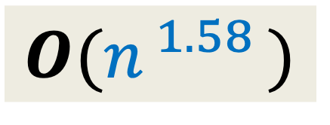




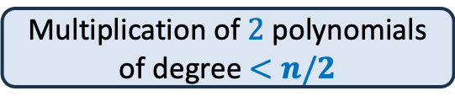

$O(n^{\log_{2}3})$ time algorithm
$$O(n^{ 1.58 })$$
$$A\left(x\right)=A_{first}\left(x\right)+{ x}^{\frac{n}{2}} A_{second}\left(x\right)$$
$$B\left(x\right)=B_{first}\left(x\right)+{ x}^{\frac{n}{2}} B_{second}\left(x\right)$$
$A\left(x\right)×B\left(x\right)$ =
$$4 ×$$
Multiplication of $2$polynomials of degree $<n/2$
$T(n) = cn + 4 T(n/2)$
Homework
$$3$$

Slide 9

Representation of a polynomial ?
Coefficient representation:
$$A\left(x\right)=a_{0}+a_{1}x+a_{2}x^{2}+ …a_{n−1}x^{n−1}$$
$<a_{0}, a_{1},a_{2},…,a_{n−1}>$

Slide 10
Representation of a polynomial ?
Alternate representation of polynomial
“$A\left(x\right)=a_{0}+a_{1}x$”
{$(r_{0}, A\left(r_{0}\right)),(r_{1}, A\left(r_{1}\right))$}
for any distinct $r_{0}$ and $r_{1}$uniquely define $A\left(x\right)$.
Alternate representation of polynomial “$A\left(x\right)=a_{0}+a_{1}x+a_{2}x^{2}$”
{$(r_{0}, A\left(r_{0}\right)),(r_{1}, A\left(r_{1}\right))$, $(r_{2}, A\left(r_{2}\right))$}
for any distinct $r_{0}$,$r_{1}$, and $r_{2}$ uniquely define $A\left(x\right)$.
$$(r_{1}, A\left(r_{1}\right))$$
$$(r_{2}, A\left(r_{2}\right))$$
$$(r_{0}, A\left(r_{0}\right))$$
$$(r_{1}, A\left(r_{1}\right))$$
$$(r_{0}, A\left(r_{0}\right))$$

Slide 11

Representation of a polynomial ?
Theorem:
Let {$(r_{0},t_{0}),(r_{1},t_{1})$, …, $(r_{m−1}, t_{m−1})$} be $m$ pairs of numbers with all $r_{i}$’s distinct.
There exists a unique polynomial $A$ of degree less than $m$ such that
$A\left(r_{i}\right)=t_{i}$ $∀ i$
Proof: Elementary matrix theory.
(point,value) representation of a polynomial

Slide 12



Questions
$A$ and $B$: two polynomial of degree less than $n$,
and
$C=A × B$
and
{$r_{0},r_{1}, r_{m−1}$}: any $m$ distinct numbers
Suppose we are given {$A\left(r_{0}\right),A\left(r_{1}\right),…$ ,$A\left(r_{m−1}\right)$} and {$B\left(r_{0}\right),B\left(r_{1}\right),…$ ,$B\left(r_{m−1}\right)$}
Question 1 : How efficiently can we compute {$C\left(r_{0}\right),C\left(r_{1}\right),…$ ,$C\left(r_{m−1}\right)$} ?
Question 2 : What should be the smallest value of $m$ such that
{$\left(r_{0}, C\left(r_{0}\right)\right),…,(r_{m−1}, C\left(r_{m−1}\right)$} is a (point,value) representation of $C$ ?
O($m$) time
$$2n−1$$

Slide 13

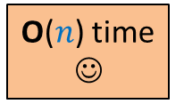

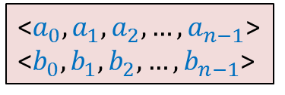
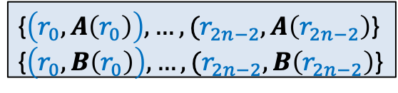
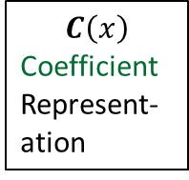


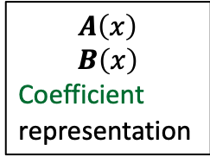

$C=A × B$
☹
$$C\left(x\right)$$
Coefficient
Represent-ation
$$A\left(x\right)$$
$$B\left(x\right)$$
Coefficient
representation
<$a_{0}, a_{1},a_{2},…,a_{n−1}$>
<$b_{0}, b_{1},b_{2},…,b_{n−1}$>
<$c_{0}, c_{1},c_{2},…,c_{2n−2}$>
O($n$ log $n$) time
O($n$ log $n$) time
Polynomial Evaluation
Polynomial Interpolation
{$\left(r_{0}, A\left(r_{0}\right)\right),…,(r_{2n−2}, A\left(r_{2n−2}\right)$}
{$\left(r_{0}, B\left(r_{0}\right)\right),…,(r_{2n−2}, B\left(r_{2n−2}\right)$}
{$\left(r_{0}, C\left(r_{0}\right)\right),…,(r_{2n−2}, C\left(r_{2n−2}\right)$}
O($n$) time
☺

Slide 14


Polynomial Evaluation Problem
Given a polynomial $A$ of degree less than $n$in coefficient representation,
Choose any set $S$ of $n$ numbers
Compute $A\left(v\right)$ for all $v∈S$.
Please choose set $S$as per your wisdom, and freeze it
with a hope that it would be help design an efficient algorithm ☺.

Slide 15
a Divide and Conquer algorithm for
Polynomial Evaluation Problem

Slide 16


Divide Step
Idea ?
$$A\left(x\right)=a_{0}+a_{1}x+a_{2}x^{2}+ …a_{n−1}x^{n−1}$$
$$S$$
Try to express $A\left(x\right)$ as 2 polynomials of degree less than $\frac{n}{2}$.

Slide 17

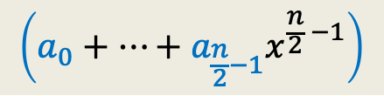






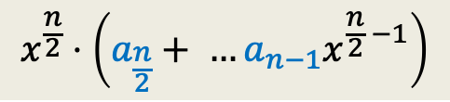
Divide Step
Attempt 1
$$A\left(x\right)=a_{0}+a_{1}x+a_{2}x^{2}+ …a_{n−1}x^{n−1}$$
$$S$$
$$A\left(x\right)= ? + ?$$
Evaluating $A$ at $S$ =
$$\left(a_{0}+…+a_{\frac{n}{2}−1}x^{\frac{n}{2} −1}\right)$$
$$x^{\frac{n}{2}}⋅\left(a_{\frac{n}{2}}+ …a_{n−1}x^{\frac{n}{2} −1}\right)$$
$$A_{first}\left(x\right)$$
$$A_{second}\left(x\right)$$
Evaluating $A_{first}$ at $S$
Evaluating $A_{second}$ at $S$
Evaluating $x^{\frac{n}{2}}$ at $S$
$+$ O($n log n$) time
O($n log n$) time
$+$ O($n$) time
Notes:
We can evaluate x^{n/2} in log n time for any given value of x: by repeated squaring:
For example, to compute x^1024, we compute and square x^512.
To compute x^512, we compute and square x^128.
To compute x^128, we copute and square x^64
…
To compute x^2, we square x.
So just O(log n) arithmetic operations are needed.

Slide 18

Divide Step
Attempt 1
$$A\left(x\right)=a_{0}+a_{1}x+a_{2}x^{2}+ …a_{n−1}x^{n−1}$$
$$S$$
$$A\left(x\right)= ? + ?$$
Evaluating $A$ at $S$ =
$$\left(a_{0}+…+a_{\frac{n}{2}−1}x^{\frac{n}{2} −1}\right)$$
$$x^{\frac{n}{2}}⋅\left(a_{\frac{n}{2}}+ …a_{n−1}x^{\frac{n}{2} −1}\right)$$
$$A_{first}\left(x\right)$$
$$A_{second}\left(x\right)$$
Evaluating $A_{first}$ at $S$
Evaluating $A_{second}$ at $S$
Evaluating $x^{\frac{n}{2}}$ at $S$
$+$ O($n log n$) time
What is the recurrence of the algorithm ?
$T\left(n\right)= cn log n + 2 T(n/2)$
Notes:
We can evaluate x^{n/2} in log n time for any given value of x: by repeated squaring:
For example, to compute x^1024, we compute and square x^512.
To compute x^512, we compute and square x^128.
To compute x^128, we copute and square x^64
…
To compute x^2, we square x.
So just O(log n) arithmetic operations are needed.

Slide 19






The Recursion Tree
points
for
evaluation
$A\left(x\right)=$ $A_{first}$($x$) + $x^{\frac{n}{2}} A_{second}$($x$)
degree
$$A$$
$$<n$$
$$S$$
$$n$$
$$A_{first}$$
$$A_{second}$$
$$<n/2$$
$$S$$
$$n$$
$$<n/4$$
$$S$$
$$n$$
$$<1$$
$$S$$
$$n$$
$n$ polynomials, each to be evaluated at $n$ distinct numbers
$Θ\left(n^{2}\right)time$☹

Slide 20

















Divide Step
Attempt 2
$$A\left(x\right)= ? + ?$$
$A_{even}(x)$= $a_{0}+a_{2}x+ …+a_{n−2}x^{\frac{n}{2}−1}$
$A_{odd}(x)$ = $a_{1}+a_{3}x+ …+a_{n−1}x^{\frac{n}{2}−1}$,
Evaluating $A$ at $S$ =
$$A\left(x\right)=a_{0}+a_{1}x+a_{2}x^{2}+ …a_{n−1}x^{n−1}$$
$$S$$
$$\left(a_{0}+a_{2}x^{2}+…+a_{n−2}x^{n−2}\right)$$
$$(a_{1}x+a_{3}x^{3}+…+a_{n−1}x^{n−1}\text{)}$$
All odd terms of $A\left(x\right)$
All even terms of $A\left(x\right)$
$x⋅(a_{1}+a_{3}x^{2}+…+a_{n−1}x^{n−2}$)
$$a_{2i}{ x}^{2i}$$
$$a_{2i}{ (x^{2})}^{i}$$
$$a_{2i+1}{ (x^{2})}^{i}$$
$$a_{2i+1}{ x}^{2i}$$
$A\left(x\right)=$ $A_{even}$($x^{2}$) + $x A_{odd}$($x^{2}$)
Evaluating $A_{even}$ at ?
$$S^{2}=$$
$$\left\{c^{2} \right| c∈S\}$$
$$S^{2}$$
Evaluating $A_{odd}$ at $S^{2}$
$+$ O($n$) time

Slide 21

The Recursion Tree
points
for
evaluation
$A\left(x\right)=$ $A_{even}$($x^{2}$) + $x A_{odd}$($x^{2}$)
degree
$$A$$
$$<n$$
$$S$$
$$n$$
Question: Is it possible to select $S$ such that
…
$$A_{even}$$
$$A_{odd}$$
$$<n/2$$
$$S^{2}$$
$$n$$
$$<n/4$$
$$S^{4}$$
$$n$$
$$<1$$
$$S^{n}$$
$$n$$
$n$ polynomials, each to be evaluated at $n$ distinct numbers
$Θ\left(n^{2}\right)time$☹
This hurdle is pointing to a very important question whose answer will solve this problem …
$${|S}^{2}|=\frac{n}{2}$$
$${|S}^{4}|=\frac{n}{4}$$
Now recall the set $S$
you selected. What is the size of $S^{2}$, $S^{4}$, …, $S^{n}$ ?
$${|S}^{n}|=1$$

Slide 22
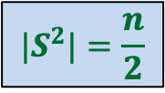



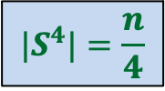
Question
Is it possible to select $S$ such that
…
$$|S^{2}|=\frac{n}{2}$$
$S$ = $\{2,3,9,−2,−3,−9\}$
$${|S}^{4}|=\frac{n}{4}$$
Good start !
But how to satisfy the remaining requirements …
Complex numbers
$${|S}^{n}|=1$$
Complex roots of unity

Slide 23
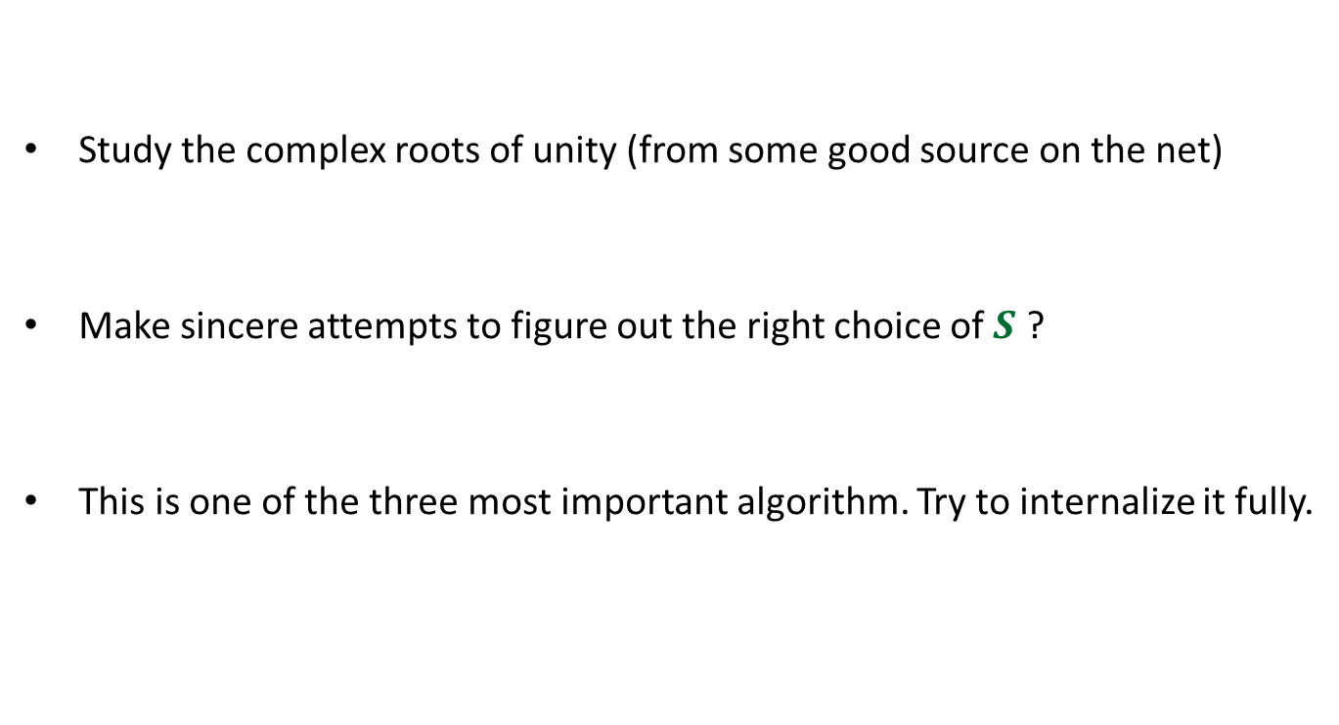
Homework
Study the complex roots of unity (from some good source on the net)
Make sincere attempts to figure out the right choice of $S$ ?
This is one of the three most important algorithm. Try to internalize it fully.

